Slide 1
Why Arent flights delayed?
By: Kenneth Morgan
Torina lewis, ph.D
HBCu-up Research internship, 2019

Slide 2
Abstract
In the world today, researchers have stated that approximately 8-15% percent of the people that book a flight somewhere in the world, misses their intended predicted flight. Approximately, 5% are late to their flight and out of all the flights flown in one complete year, 32% of the total flights are cancelled or delayed. The dataset, shows that between the initiations of the airplane to the landing of the aircraft, there are numerous variables that take effect to the timing of the flight. The variables consist of origin, weather, late aircraft, and security delay. My hypothesis states that from the Origin variable, the LAX factor will have the highest delay rate. The data used in this research comes from open educational resources. The clean dataset has about 1.1 million observations and 30 variables. Numerous data wrangling techniques provided me with a blueprint in which helped me reduced my dataset to approximately 60,000. A perfect reason to reducing the data is because in the dataset, there were values that were insignificant. A statistical analysis portrays a direct correlational between the variables in the dataset. From the statistical analysis, one can see that there are three variables that were significant. The analysis will show which one of the variables will have the biggest effect on the probability for lessening a delayed flight. Next, we use machine learning to create models that will help implement criteria for the data. From here we solidify the purpose of the research, which is to find a variable or variables that will lower the probability of a delayed flight in ATL or LAX.

Slide 3
Research question(s)
Which variable will have the biggest impact on lowering the probability of a delayed flight in ATL or LAX?
Which airport has the highest delay rate?

Slide 4
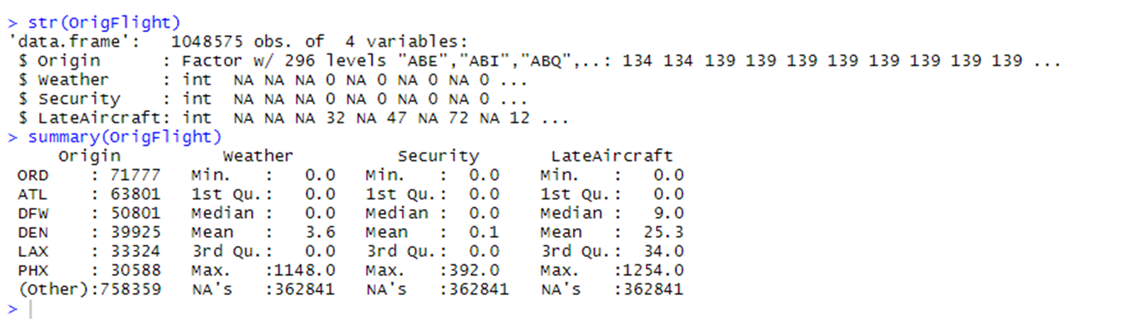
Original dataset
(Below) is a screenshot from the original dataset. The dataset has a little over a million observations with 4 variables.

Slide 5
Data wrangling
By analyzing data from this dataset, the best way to catch trends in the data values is a scatter plot. A scatter plot is analogous to the line graph in which values will be will be measured over time. I can translate my data into a scatter plot and watch the variations in the delay times. The two airports will be measured from a month span of delayed flights. Each airport, ATL and LAX will have variations in delay times. The airport with the higher frequency in delay flights will be one that I feel needs to work on airport services and efficiency techniques, so that the high frequency obtained, can be lowered. From this, one can find build a model using the different times.

Slide 6
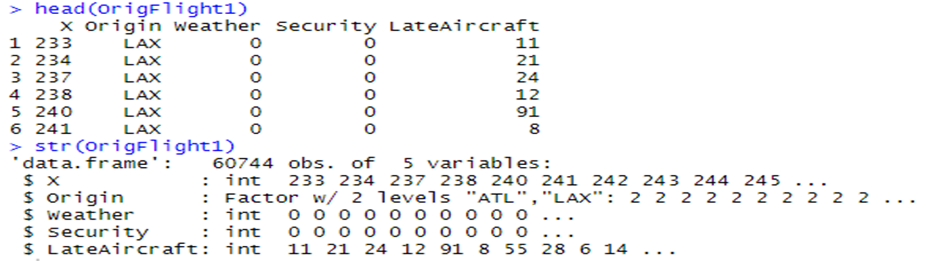
Cleaned Dataset
(Below) is the outcome from a couple data wrangling techniques. The observations from the original dataset decreased significantly. However, there was a variable increase. The “X” variable was removed by a code and resulted in the 4 original variables.

Slide 7
Statistics analysis
With the clean dataset having significant variables. The variables had numerous values of delay times. Those times were plotted into different scatter plots. The scatter plots in the analysis displayed numerous variations in the delay times with respect to the independent variables taking affect onto the dependent variable. The graphs help one understand how the variables impacted the delay times, on the Origin variable.

Slide 8
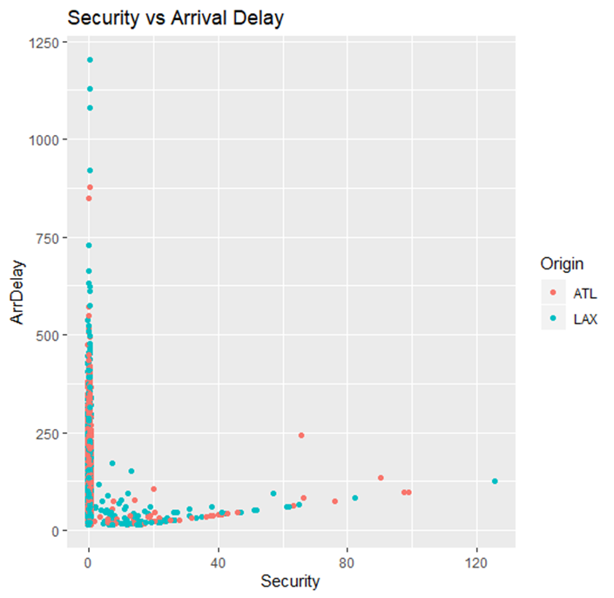
Security vs arrival delay
Detailed in this graph is an independent variable graphed along the changed independent variable. There is little to no correlation here, therefore, this graph shows no impact on the independent variable.

Slide 9
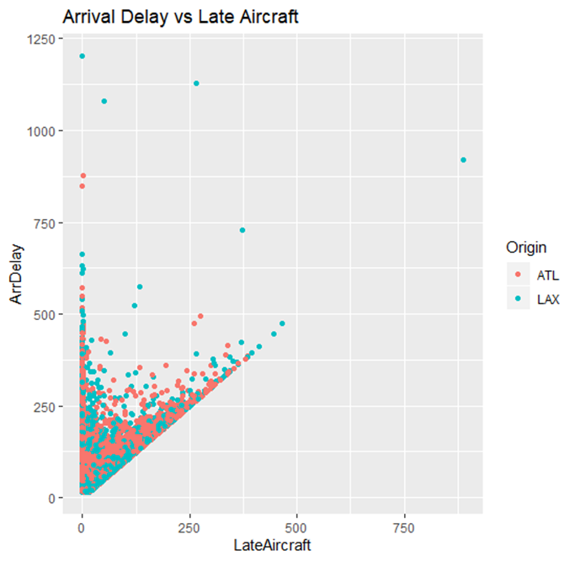
Arrival delay vs late aircraft
There is a positive correlation between these two variables. However, there was little impact on the independent variable.

Slide 10
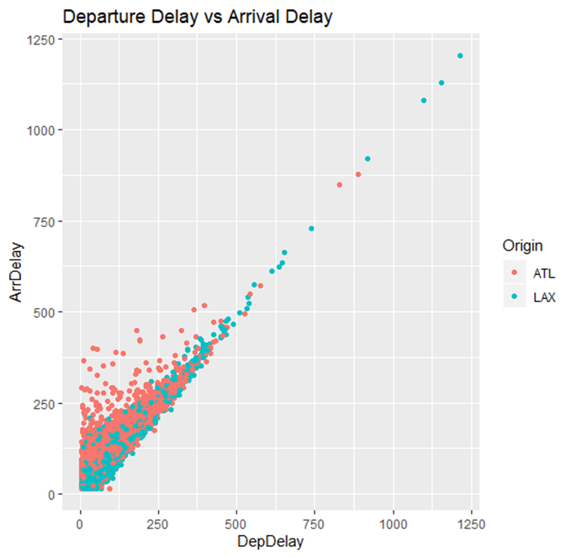
Departure delay vs arrival delay
Looking into the graph, one can see the linear mapping of positive delay values. These values are following a efficient slope which results in a good correlation between the two variables.

Slide 11
Machine learning
The model that was used to predict the probability decrease was a Linear Regression model. A code in R, helped find the best fit model. While finding the model, a cross-validation method was used to find 5 iterations of a the best fit model for the data given. Therefore, the result from this was “model4.”

Slide 12
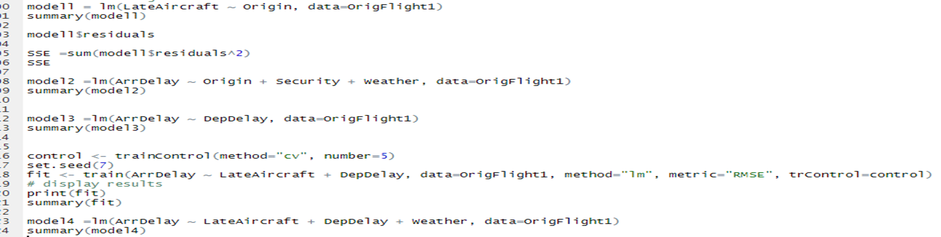
Machine learning code
To determine if the variables were significant to the data, these linear regression models were ran. Due to the independent variable change, the best fit model came from the cross-validation model. The last model was the model that gave me the closest R-squared value with little standard error.

Slide 13
results
Results that came from the components of the experiment were interesting. The first model, “model2”, was ran and showed a R-squared value of .0117. This indicated the model was not best fit for the regression model. Therefore, I had to change an independent variable in the model. From here, I changed “Late Aircraft” to “Arrival Delay”. This variable however, was ran with the dependent variable and resulted in a model that displayed a R-squared of .8842. I knew that this model was more significant due to the value being close to 1. This model also showed a standard deviation that was lower than the first model. Then, the p-value for the model was low also. All validating the best fit model for the dataset. In conclusion, this showed me that the variable of Late Aircraft was not significant to the model. My hypothesis was wrong and the machine learning assisted me in finding the best fit model.

Slide 14
Future work
From the first dataset, there were more than 50 different airports. The cleaned dataset and dataset that was analyzed had two major US airports. I would like to expand my research to more airports around the US. The variables that I would like to work with in the future will have a higher level of significance in a model. Therefore, the probability of delayed flights will be lowered in the US, once the variables are manipulated. From this, I would like to analyze data from large datasets and create models that will analyze numerical values distinctively.

Slide 15
Acknowledgments
It has been a pleasure to work with Clark Atlanta University and its HBCU-UP research program. I would like to thank Dr. Eric Mintz and Dr. Torina Lewis for giving me this wonderful opportunity. This has been a wonderful experience for me. I will use the information and knowledge that I learned this summer to help pave the way for my data science career. This research opportunity was sponsored by the National Science Foundation, award numbers 1700408 and 1818682.

